Slide 1
Dimensionality
DSGT Hackalytics
https://tinyurl.com/y44q462j

Slide 2
Goal of Data Science
Given features, derive conclusions
 | Feature | Feature | Feature
Expt | 2342.23 | 674.56 | 11234.5
Expt | 1234.13 | 3423.5 | 256.23
Expt | 123.53 | 954.3 | 2345.5
Expt | 43345.3 | 847.34 | 763.432
Expt | 34598.5 | 845.5 | 4365.4
Expt | 8564.3 | 743.2 | 9765.3
Expt | 54634.3 | 1345.3 | 98623.4
Regression
Classification

Slide 3
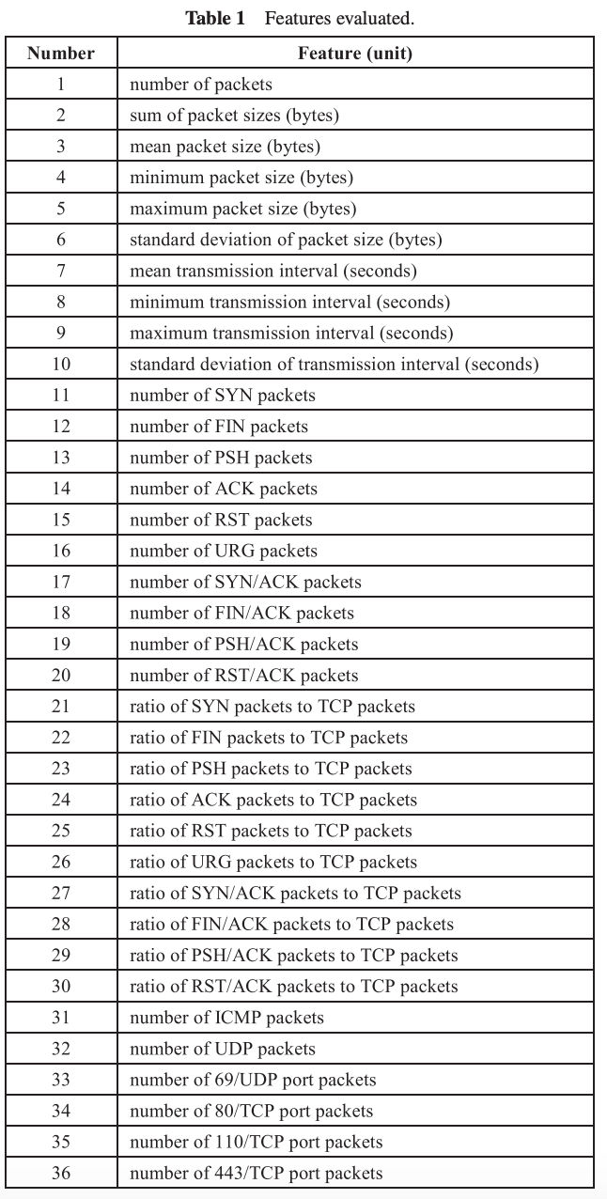
Many Dimensions
Potentially 100s-1000’s of features
What happens when you perform operations?
Try to make conclusions?
n¹=123
n²=15129
n³=1,860,867

Slide 4
Drawbacks
Storage costs
Computational overhead
Runtime speed
Redundancy in data
Loss of statistical significance
Decreased accuracy from ML models
Hughes phenomenon
Overfitting
Inability to visualize

Slide 5
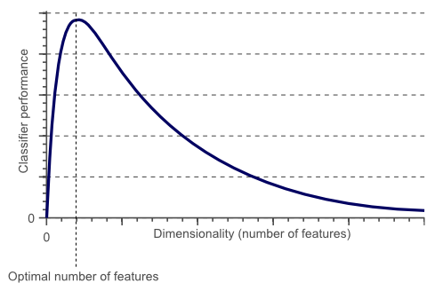
Curse of Dimensionality/Hughes Phenomenon
As the number of features increases, so does accuracy up to a specific point
Then declines
Occam’s Razor
Simple is better

Slide 6
Curse of Dimensionality/Overfitting/underfitting
Too few features → underfit
Too many features → overfit
Regularization? → only for some algorithms (ex. not KNNS)

Slide 7
Dimensionality Reduction
Feature selection
Only keep most informative features
Use existing
Feature extraction
Find combinations to create new features
Create new

Slide 8
Dimensionality Reduction
Feature selection
Feature extraction
Keep most informative features
Create new features using combinations
a1 + a2 + a3 =

Slide 9
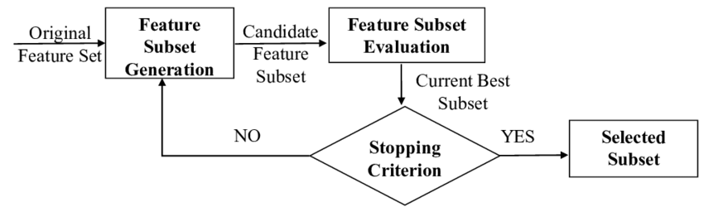
Feature Selection: Intuitive
Forward feature selection
Backward feature elimination

Slide 10
Feature Selection: Intuitive
Forward feature selection
Backward feature elimination

Slide 11
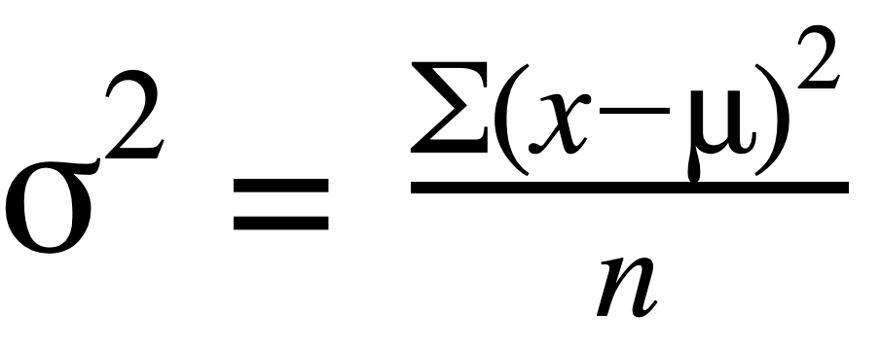
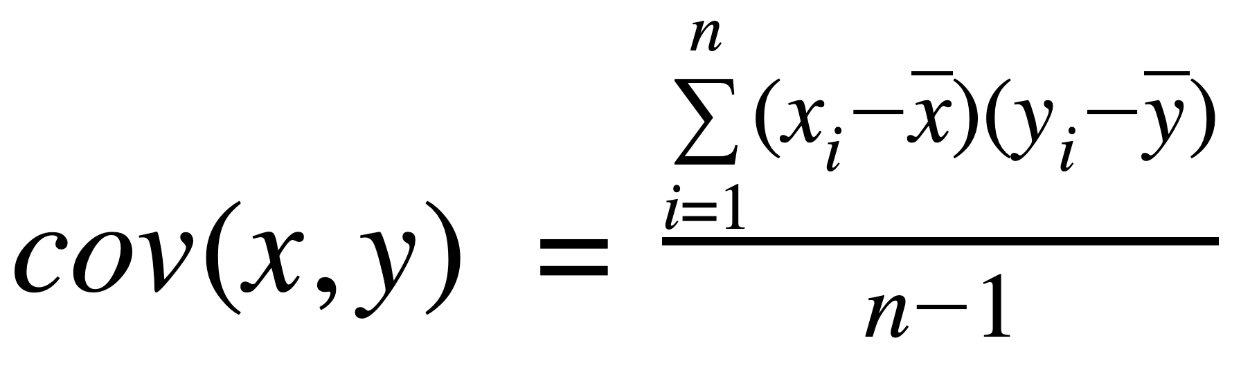
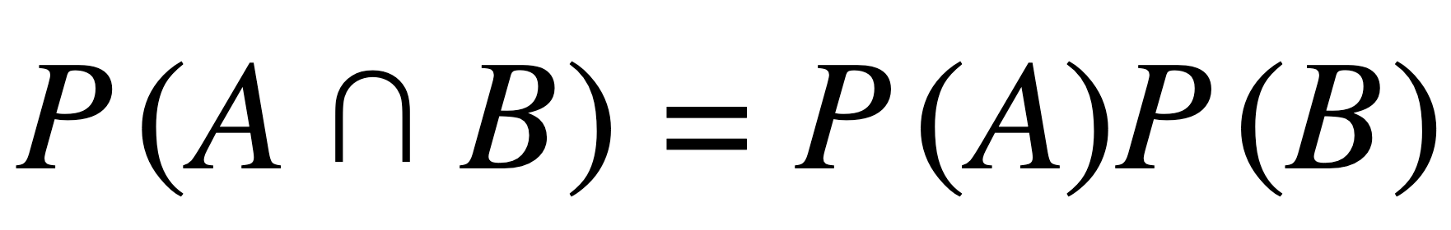
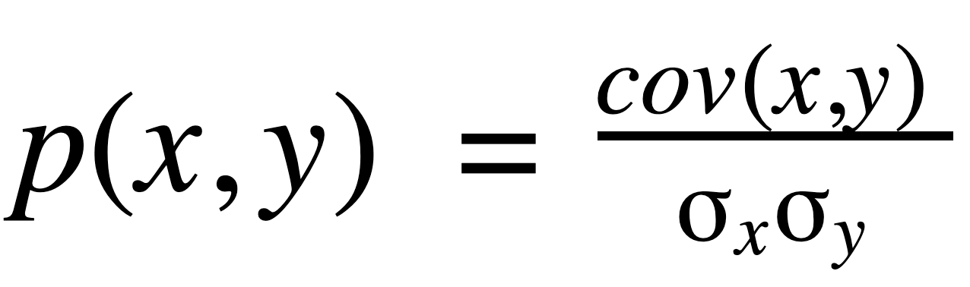
Statistics Breakdown
Feature | Definition | Equation
Variance | How spread out data is
Covariance | Variance between samples (problem: units)
Independance | Variables do not depend on each other
Correlation | Normalized covariance (units)

Slide 12
Feature Selection: Intuitive
Missing value ratio
Missing entries → potentially unreliable
Low variance filter
Drop those with low variance
High correlation
Encapsulate same information

Slide 13
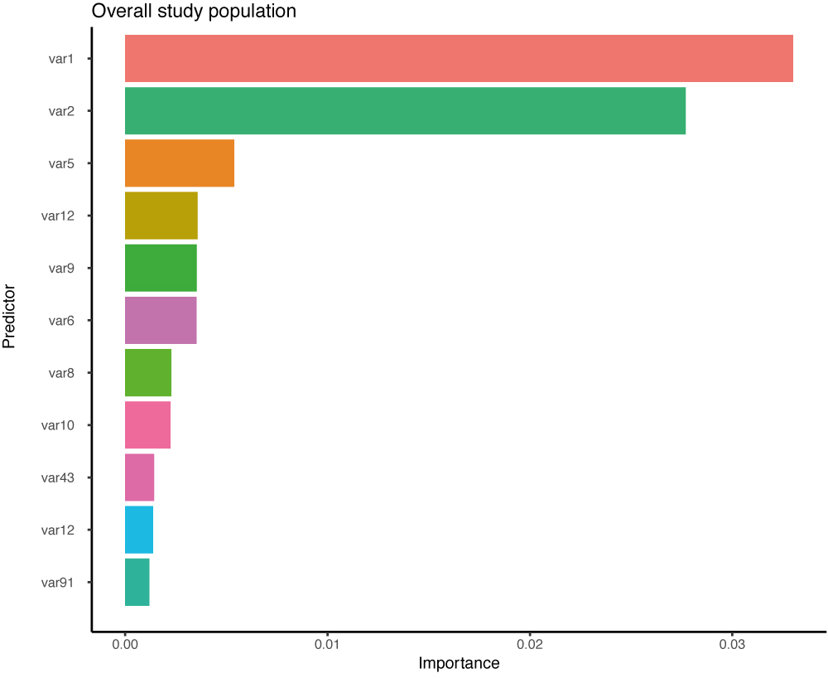
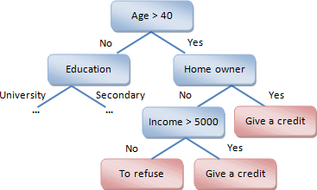
Feature Selection: Intuitive
Random forest regressor
Outputs feature importance graph
Visualize which features contribute most

Slide 14
Feature Extraction: Advanced Methods
PCA (and variants)
Manifold Learning
t-SNE
SVD
Factor analysis
UMAP
Independent component analysis

Slide 15
Linear vs Nonlinear
Separability by hyperplane
Property that dictates which algorithms suit your data

Slide 16
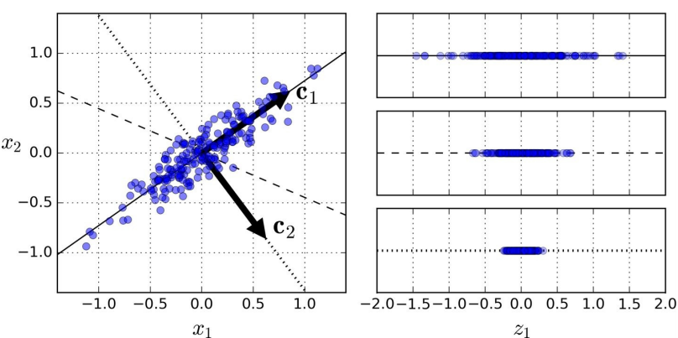
Principal Component Analysis (PCA)
Linear combinations of features
Principal components
Selected PCs best describe variance in data
First PC accounts for most variability
Second accounts for most remaining variability
…
Transforms to new coordinate system
Like redefining axes

Slide 17
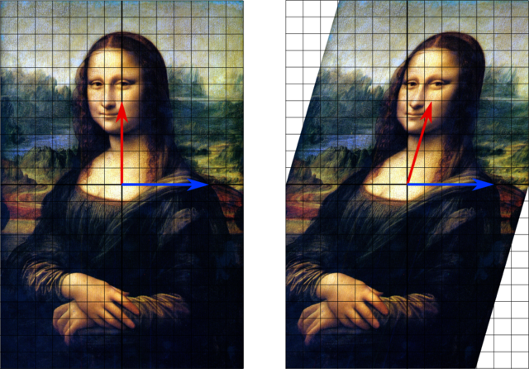
PCA: Eigenvector Based Multivariate Analysis
Eigenvector-based multivariate analysis
1) Covariance matrix
2) Eigenvalue decomposition
Decompose into PDP^-1
3) Sort eigenvalues by magnitude
Use to sort eigenvectors
Multiply covariance matrix by sorted P
Elements -- principal components
Each orthogonal to each other
Statistically independent!

Slide 18

PCA: Eigenvector Based Multivariate Analysis
Transforms to most informative viewpoint

Slide 19
PCA: Limitations and Variants
Works for linear data
Sensitive to sparsity/outliers
Uses linear combinations of ALL variables
Loses local relationships between points
Alternatives: Kernel/Robust/Sparse PCA

Slide 20
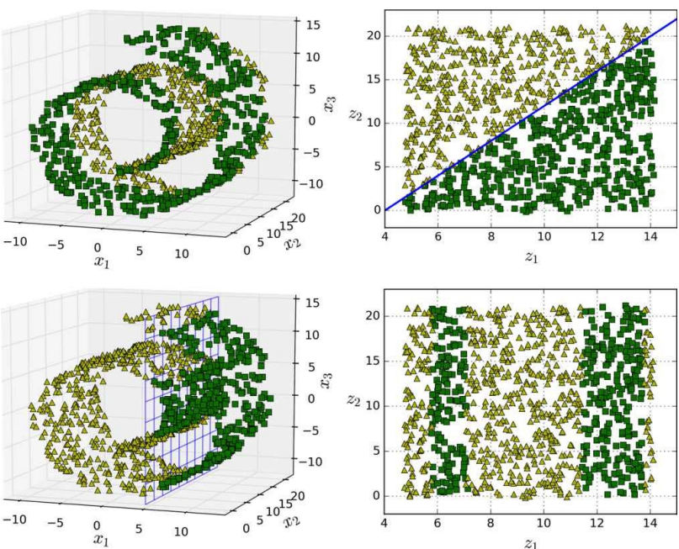
Manifold Learning
Motivation:
Just removing 1 axis loses data
Preserve local relationships
Goal:
Extract low-d manifold describing high-d data
Uses distance, not variance

Slide 21
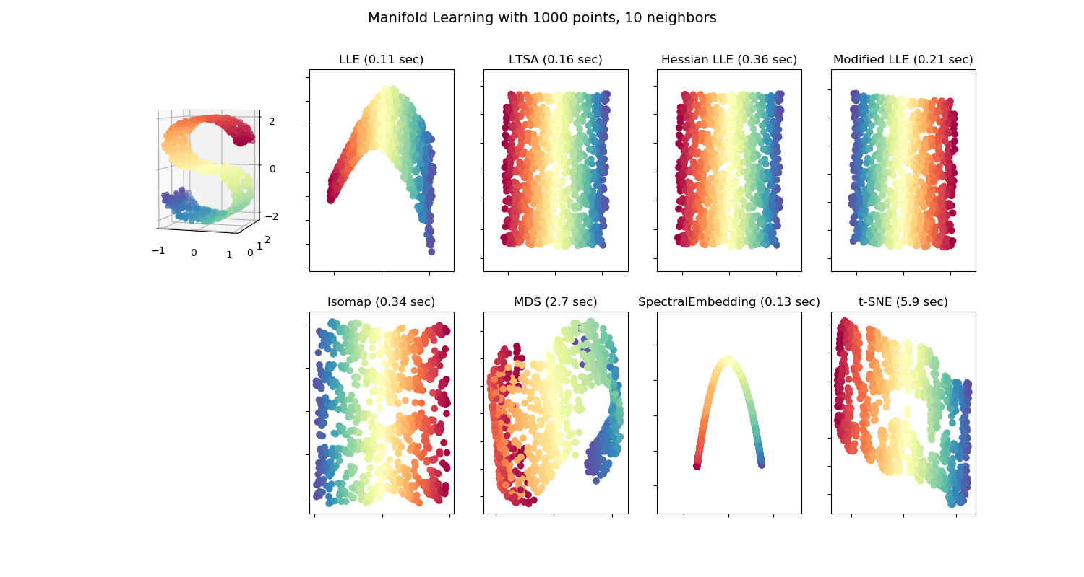
Manifold Learning
Preserves local data structure
Stronger intuition
Ability to see clusters
Nonlinear

Slide 22

Examples
Examples
t-SNE
Isomap
Local Linear Embedding
Spectral Embedding
Local Tangent Space Alignment
UMAP
Disadvantages
Cannot return to high dimensional space
Computationally expensive

Slide 23
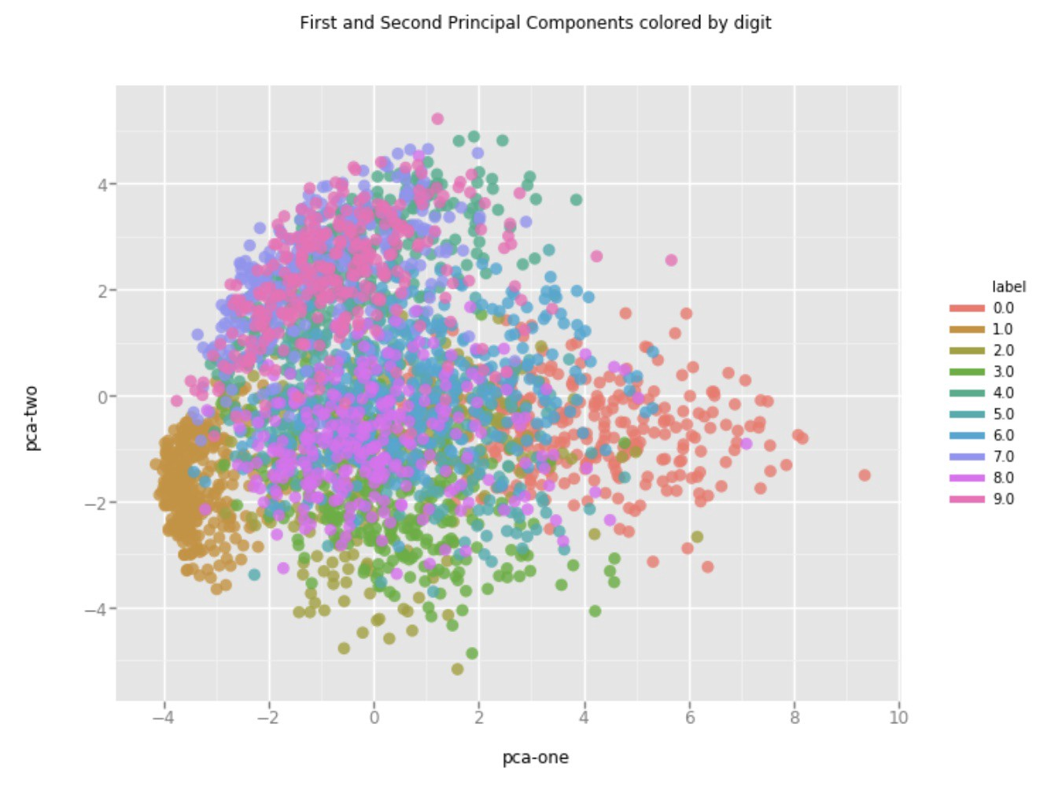
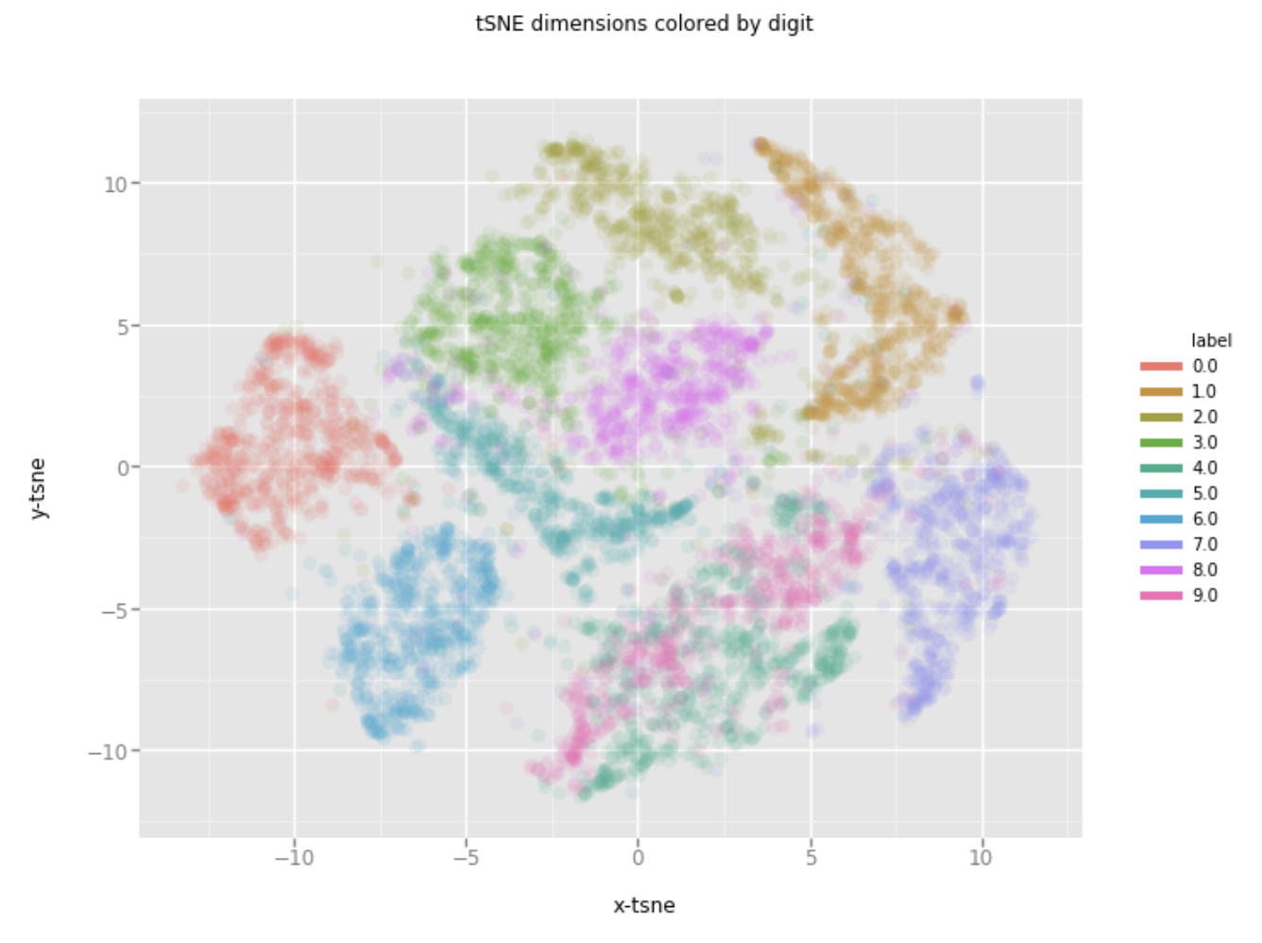
PCA vs t-SNE
Which shows clearer clusters?

Slide 24
Summary
More dimensions increases complexity
Time, accuracy, visualization, loss of statistical significance
Curse of dimensionality!
Hughes Phenomenon
Two approaches to dimensionality reduction
Feature selection - Statistics
Feature extraction - PCA/t-SNE
Which methods to choose
Linearity vs Nonlinearity
Global vs local structure preservation
Importance of visualization

Slide 25
Questions?

